Slide 1

Angular
Getting Started
By Assaf Finkelshtein
assaf.fink@gmail.com
http://linkedin.com/in/assaf-fink

Slide 2

TypeScript

Slide 3
What is TypeScript?
Strongly Typed, OOP language
Translate itself to native JavaScript
Created by Microsoft in 2013
According to GitHub – one of the most popular programming language today
Used by default in an Angular project
Official website: https://www.typescriptlang.org

Slide 4
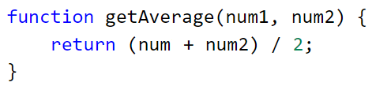
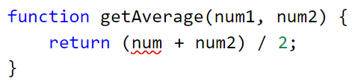
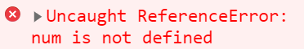
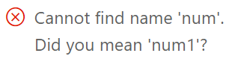


Why TypeScript?
JavaScript
TypeScript
Runtime Error:
Compilation Error:
JavaScript has no compiler
TypeScript has a compiler

Slide 5
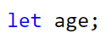
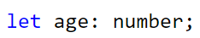
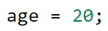
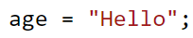
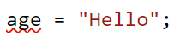
Why TypeScript?
JavaScript
TypeScript
JavaScript is not Strongly Typed
TypeScript is Strongly Typed

Slide 6
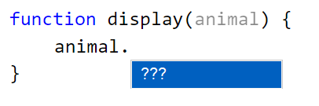
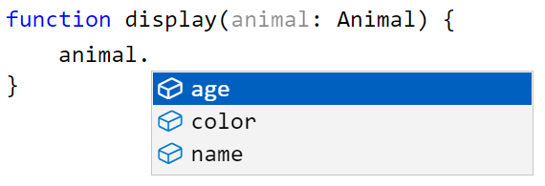
Why TypeScript?
JavaScript
TypeScript
JavaScript has a poor IntelliSense
TypeScript has full IntelliSense

Slide 7
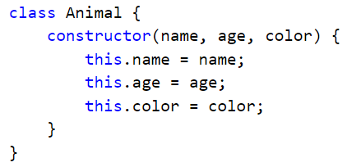
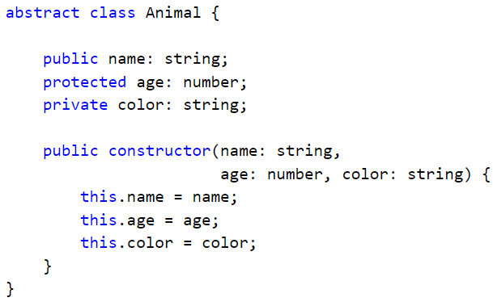
Why TypeScript?
JavaScript
TypeScript
public? / protected? / private?
abstract?
interface?
generics?
…
JavaScript has a poor OOP syntax
TypeScript has a full OOP syntax

Slide 8
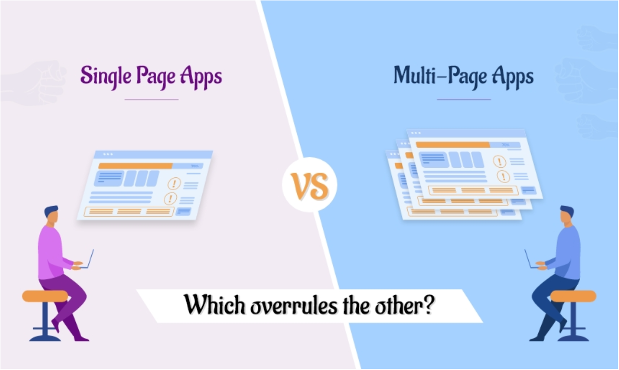
MPA vs. SPA

Slide 9
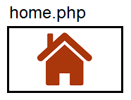

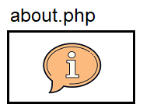

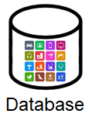



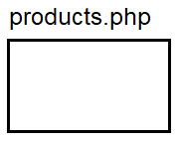

Multi Page Application
Frontend
Backend
Page
Page
Page

Slide 10
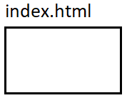
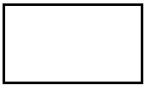



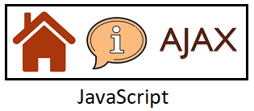
Single Page Application
Frontend
Backend
Empty Page
REST API
JSON

Slide 11

Angular

Slide 12
What is Angular?
Frontend framework for creating Single Page Applications
Created by Google in 2010
First version (1.x) is called ‘AngularJS’
Second version (2.x) and above is called ‘Angular’
Official website: https://angular.io

Slide 13
Installations
Node.js:
https://nodejs.org
Installing Angular (once on a machine):
npm install -g @angular/cli
Creating a new project:
ng new project-name [--skip-tests]
Running the project:
ng serve --open

Slide 14
Component
A component is a unit of UI
Comprise of several source files:
.html – component structure
.css – component design
.ts – component logic
.spec.ts – component unit testing
Components are the building blocks of the application

Slide 15
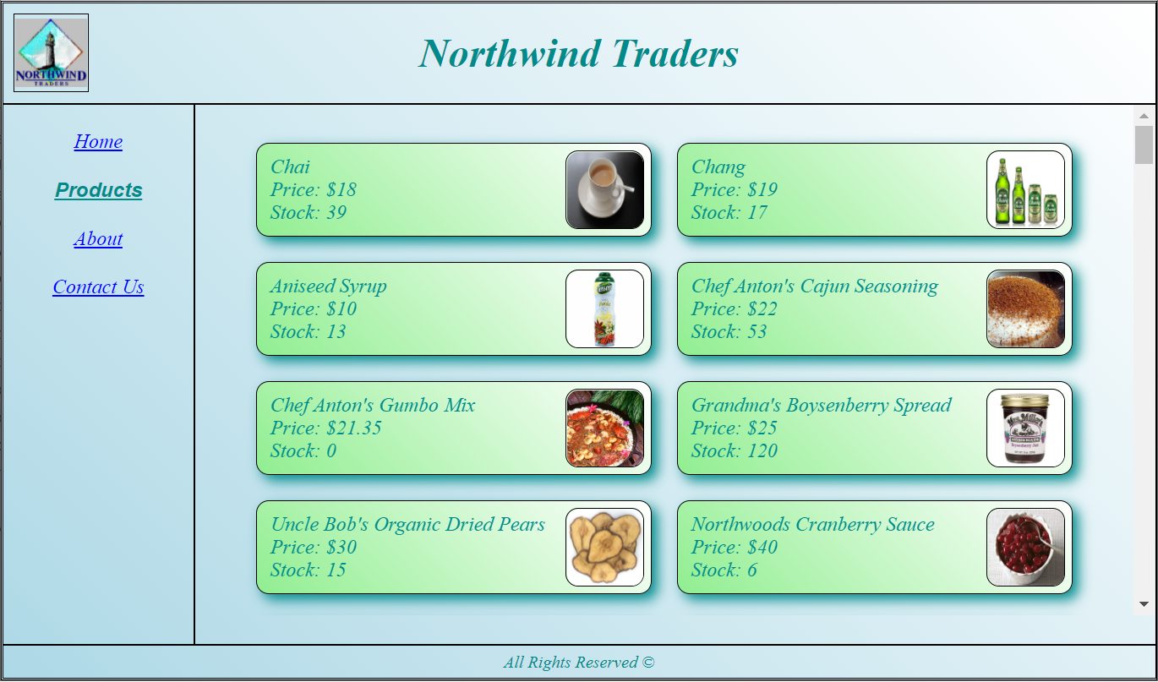
Component Based Architecture

Slide 16
Angular Module
An Angular Module is a logic container for several components
Comprise of a one source file:
.ts – module class
Each component must belong to a single Module
A new project comes with a Module named AppModule

Slide 17
Module Boundaries
Module A
Module B
Component
Component
exports a component
Component
Component
Component
Component
imports an entire module

Slide 18
Application Layout
The general structure of the app
Created by a single component building that structure
Contains other components for the layout parts (header/footer/menu…)
Usually the layout component is the one presented in the index.html

Slide 19
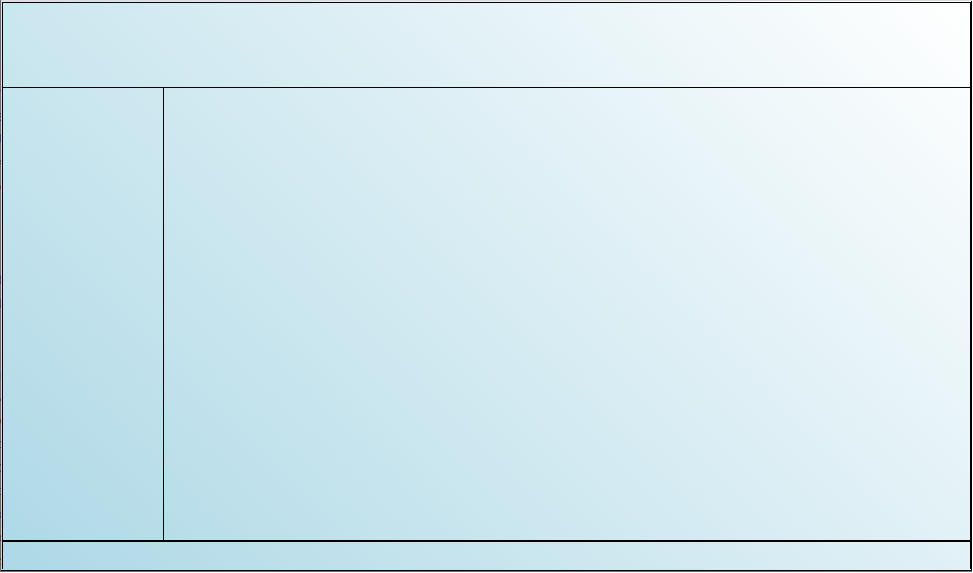
Application Layout
Layout
Header
Aside
Main
Footer

Slide 20
Data Binding
Connecting a source with a target
Any change to the source reflects immediately in the target
There are four types of Bindings:
Property Binding
Event Binding
Two-Way Binding
Interpolation
Source
Binding
Target

Slide 21
Property Binding
Connecting a class field to an HTML attribute
Any change to the field will set that value to the HTML attribute
Syntax:

Slide 22
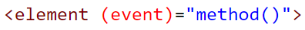
Event Binding
Connecting an HTML event to a class method
Raising the event invokes the class method
Syntax:

Slide 23
Two-Way Binding
Connecting an input element to a class field
Any change to the input element will set its value to the class field
Any change to the class field will set its value to the input element
Syntax:
Note: ngModel resides inside FormsModule which we must import

Slide 24
Interpolation
Dictionary definition:
The insertion of something of a different nature into something else
Interpolation is the insertion of a value into the HTML template
Syntax:

Slide 25
Pipe
A function for changing an interpolation value
Syntax:

Slide 26
Directives
A Directive is an instruction to an element
Causes some change to that element
There are two types of directives:
Attribute Directive
Structural Directive

Slide 27
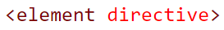
Attribute Directive
A change to an element
Can be a style change, a structural change or a behavioral change
Syntax:

Slide 28
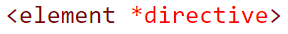
Structural Directive
First – ignores that element (not rendering it to the DOM)
Second – decides if or how many times the element should be rendered to the DOM
Syntax:

Slide 29
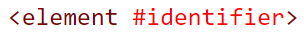
Template Reference Variable
HTML id attribute must be unique per page
Component can be reused, thus using HTML id attribute is not safe
Template Reference Variable is a safe identifier for an element instead of an id
It creates a direct reference to the element in the DOM
Can be used directly in the HTML or in the component class
Syntax:

Slide 30
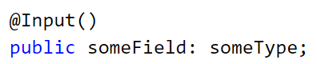
@Input
Enables to receive data from our parent component
Syntax:
Parent sends some-value:

Slide 31
Lifecycle Hooks
Unique component methods
Automatically invoked in specific times in the component’s lifecycle
Each comes from an interface implemented by the component
Most popular hooks:
ngOnInit – invoked once when the component is ready for use
ngOnDestroy – invoked once before the component is being destroyed
Complete list:
https://angular.io/guide/lifecycle-hooks

Slide 32
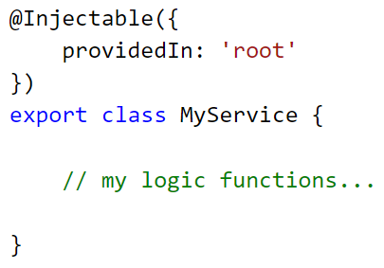
Service
A class containing some logic needed by components
Does not contain any UI
Syntax:

Slide 33
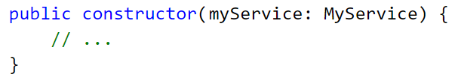
Dependency Injection (DI)
A popular design pattern
Injects a desired service object into our class
Syntax:

Slide 34
Routing
A mechanism for displaying a component according the current route
Route: the inner address of the current url:
http://www.our-site.com/home
http://www.our-site.com/products
http://www.our-site.com/news/sport/football
Defined in app-routing.module.ts
Can include default route
Can include page-not-found route
<router-outlet> element displays the routed component

Slide 35
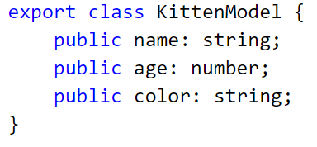
Model Class
A pure data class
Holds some data, usually given from the server via AJAX
PersonModel / CustomerModel / EmployeeModel / …
Can be created using an interface instead of a class
Example:

Slide 36
Promise
JavaScript native object
Designed to perform an asynchronous task
Reports back one success or one error
Can be run using JavaScript’s async-await syntax

Slide 37
Observable
Belongs to a library named “rxjs”
Designed to perform an asynchronous task
Reports back many successes or one error
Comes with variety of operations on the reported data
Can’t be run using JavaScript’s async-await syntax
Can transfer itself to a Promise (when reporting only one success)

Slide 38
Web Access
AJAX request to a Web Service, usually to a REST API
Is done by HttpClient service which resides in HttpClientModule
Contains all REST API methods (get/post/put/patch/delete)
Each method returns an Observable performing the AJAX request

Slide 39
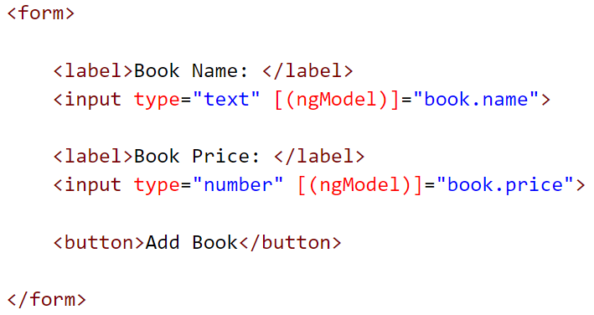
Form
Can be bind to any model via Two-Way Binding:

Slide 40
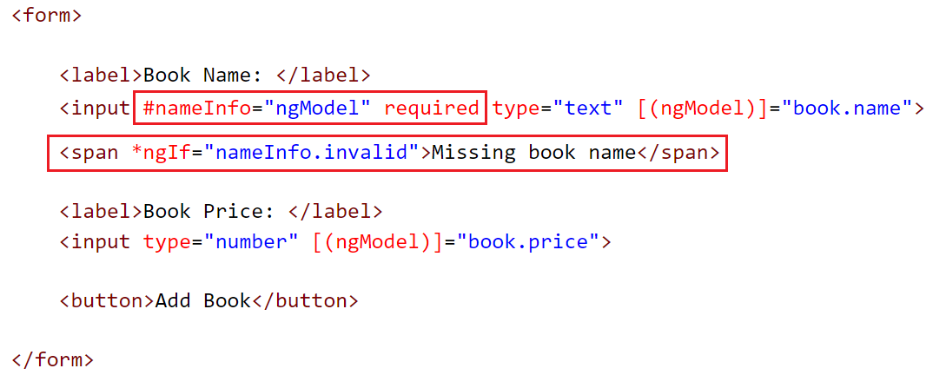
Form
Can be validated using validation attribute:

Slide 41
Thanks,
and...
Good
Luck!

